Slide 1
Common Medications and Their Side Effects
What You Need to Know...

Slide 2
Common Medications and Their Side Effects
What You Need to Know...

Slide 3
Monitoring Your Exercise Intensity
Some medications can affect your Heart Rate and Blood Pressure. If you have been using a target heart rate to get to the right exercise intensity, your healthcare provider can help to determine your new target heart rate using a brief exercise stress test . This test is used because medications affect everyone differently.
The other way to monitor your intensity is to make sure you’re not too exhausted. This is why we use the RPE Scale during Keep Stepping. It is a scale of how much you feel you are exerting yourself.

Slide 4
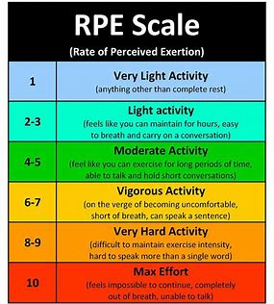

Slide 5
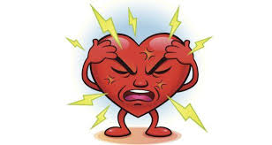
Beta Blockers...
... are a type of cardiac medication prescribed to improve survival after a heart attack. They are also used to treat conditons like arrythmia (abnormal heart rhythms), high blood pressure, angina (chest pain) or congestive heart failure.
...can also be used to treat glaucoma, migraines, anxiety disorders, tremors and overactive thyroid
...relieve stress on your heart by slowing the heartbeat.

Slide 6
Common Names of Beta Blockers
Propranolol (Inderal)
Metoprolol (Lopressor)
Atenolol (Tenormin)
Acebutolol (Sectral)
Bisoprolol (Zebeta)
Nadolol (Corgard)

Slide 7
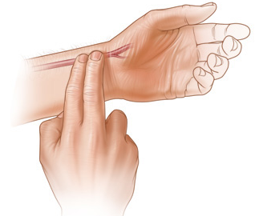
Effects of Beta Blockers on the Heart
↓ Heart Rate and Blood Pressure both at resting and exercise
↓ or ↔ Exercise Capacity in patients without angina
↑ Exercise Capacity in patients with angina

Slide 8
Side Effects of Beta Blockers
Dizziness Weakness
Drowsiness or fatigue Cold hands and feet
Dry mouth, skin, or eyes Headache
Diarrhea or constipation Upset stomach

Slide 9

Afterload Reducers...
...treat high blood pressure & congestive heart failure
...open & relax blood vessels (arteries & veins), so the heart can pump fresh oxygen & blood to the body more efficiently
...reduce chest pain caused from lack of blood flow to the heart

Slide 10
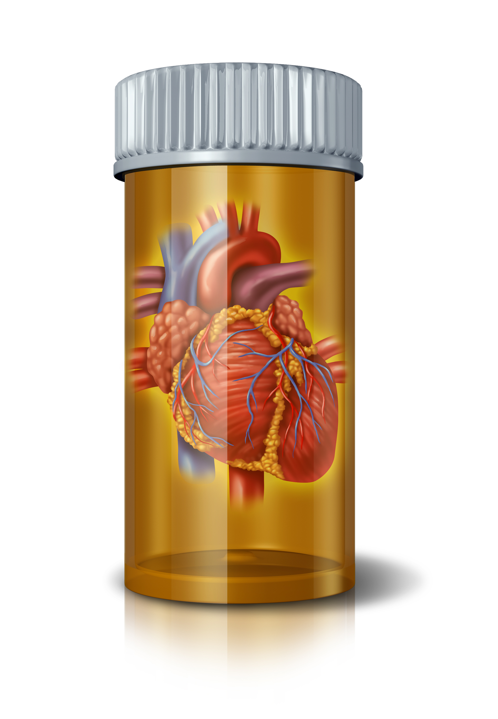
Common Names of Afterload Reducers
ACE inhibitors
Angiotensin ll blockers
Hydralazine (Apresoline)
Minoxidil (Loniten)

Slide 11
Effects of Afterload Reducers on the Heart
Vasodilators
↑ or ↔ Heart Rate both at resting and exercise
↓ Blood pressure both at resting and exercise
Exercise Capacity ↔ except ↑ or ↔ in patients with CHF
ACE inhibitors & Angiotensin ll blockers
↔ Heart Rate both at resting and exercise
↓ Blood pressure both at resting and exercise
Exercise Capacity ↔ except ↑ or ↔ in patients with CHF

Slide 12
Side Effects of Afterload Reducers
Rapid heartbeat (tachycardia)
Heart palpitations (fluttering)
Fluid retention (edema)
Nausea, Vomiting
Flushing (warmth & redness of skin)
Headache
Fatigue
Excessive hair growth
Joint pain
Chest pain

Slide 13
Calcium Channel Blockers...
...treat a variety of conditions, such as high blood pressure, chest pain and Raynaud's disease
...prevent calcium from entering cells of the heart and blood vessel walls, resulting in lower blood pressure
...relax and widen blood vessels by affecting the muscle cells in the arterial walls
Some calcium channel blockers have the added benefit of slowing your heart rate, which can further reduce blood pressure, relieve chest pain (angina) and control an irregular heartbeat.
Some calcium channel blockers are available in short-acting and long-acting forms. Short-acting work quickly, but their effects last only a few hours. Long-acting are slowly released to provide a longer lasting effect.

Slide 14

Common Names of Calcium Channel Blockers
Amlodipine (Norvasc)
Diltiazem (Cardizem, Tiazac, others)
Felodipine
Isradipine
Nicardipine
Nifedipine (Adalat CC, Afeditab CR, Procardia)
Nisoldipine (Sular)
Verapamil (Calan, Verelan)

Slide 15
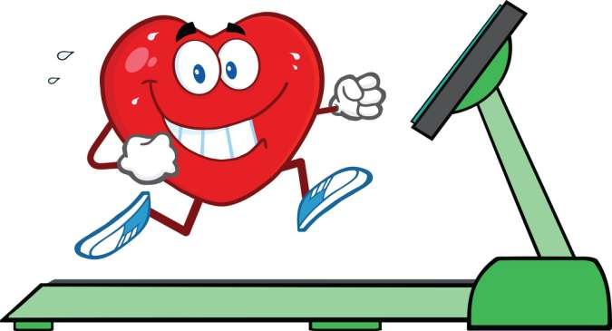
Effects of Calcium Channel Blockers on the Heart
Many Calcium Channel Blockers have no effect on Heart Rate or Blood Pressure but:
↑ Exercise Capacity in patients with angina
↔Exercise Capacity in patients without angina
Nicardipine:
↓ or ↔ both Resting and Exercise Heart Rate
↓ both Resting and Exercise Blood Pressure
Verapamil:
↓ both Resting and Exercise Heart Rate

Slide 16
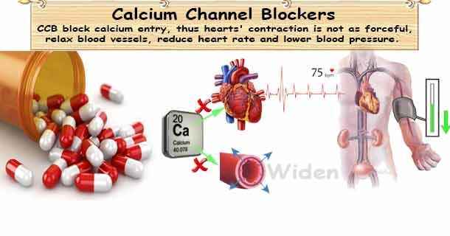

Slide 17

Side Effects of Calcium Channel Blockers
Constipation
Headache
Palpitations
Dizziness
Rash
Drowsiness
Flushing
Nausea
Swelling in the feet and lower legs
Certain calcium channel blockers interact with grapefruit products

Slide 18
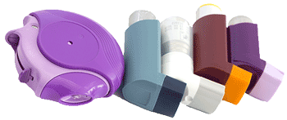
Inhalers...
Long Term Control (preventer)
Taken regularly to control chronic symptoms & prevent asthma attacks.
Most people take every day to prevent symptoms coming on by calming down the inflammation in the airways.
Quick Relief (reliever)
Taken as needed for rapid, short-term relief of symptoms. Used to prevent or treat asthma attack.
Medicine goes straight to lungs to quickly relax the muscles surrounding the airways, allowing the person to breath easy within minutes.
If a person is using more than 3x per week, contact doctor as asthma isn’t managed well.

Slide 19
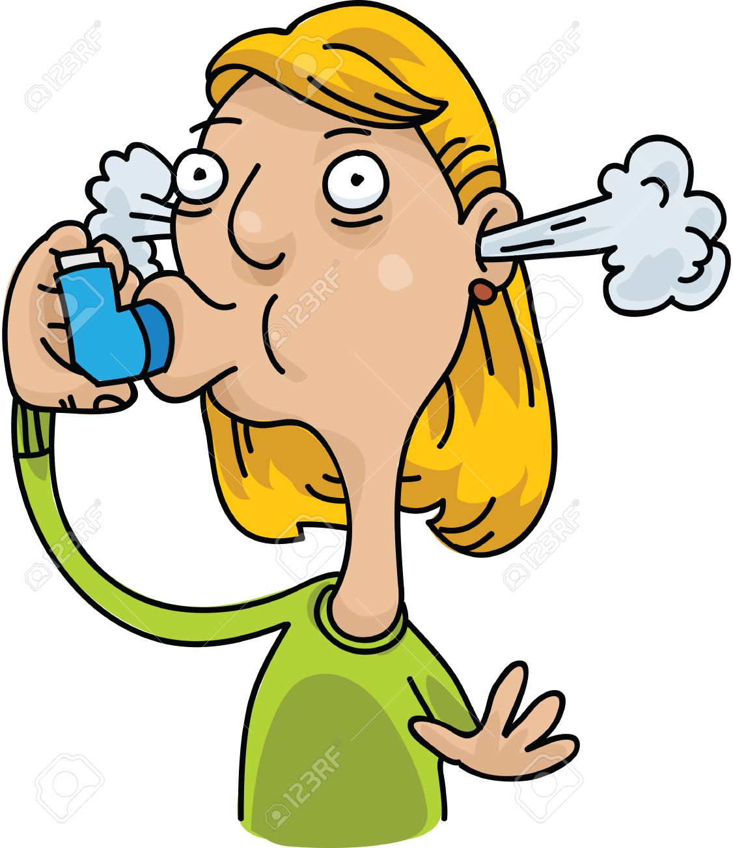
Common Names of Inhalers
Long Term Control
Salmeterol (Serevent)
Formoterol (Foradil, Perforomist)
Fluticasone (Flovent HFA)
Budesonide (Pulmicort)
Mometasone (Asmanex Twisthaler)
Beclomethasone (Qvar)
Ciclesonide (Alvesco)
Flunisolide (Aerospan HFA)
Quick-Relief
Albuterol (ProAir HFA, Ventolin HFA)
Levalbuterol (Xopenex HFA)

Slide 20

Ways to Improve Lung Health for Managing Asthma
Ginger, figs, garlic help in reducing symptoms of asthma.
Inhaling steam helps open airways to lungs.
Breathing techniques: breathe through the nose rather than the mouth
Yoga & meditation: help with relaxation & deep breathing exercises

Slide 21
Side Effects of Inhalers
Reliever (Quick Relief)
Heart beats faster for a short while
Muscles shake slightly
Preventer (Long Term)
Hoarse voice
Sore throat
Headache
Dizziness
Sleep problems
Muscle weakness
Runny/stuffy nose
Nausea/vomiting
Coughing
Muscle pain
Diarrhea
Osteoporosis
Mood changes
Forgetfulness
Hair loss
Easy bruising
High blood pressure
Diabetes

Slide 22
Resources
American Heart Association (2018), How do Beta Blocker Drugs Affect Exercise? Retrieved from:
http://www.heart.org/en/health-topics/consumer-healthcare/medication-information/how-do-beta-blocker-drugs-affect-exercise
Asthma medications: Know your options. (2018, August 02). Retrieved September 18, 2018, from
https://www.mayoclinic.org/diseases-conditions/asthma/in-depth/asthma-medications/art-20045557
Mayo Foundation for Medical Education and Research (1998-2018), Calcium Channel Blockers. Retrieved from:
https://www.mayoclinic.org/diseases-conditions/high-blood-pressure/in-depth/calcium-channel-blockers/art-20047605
Mayo Foundation for Medical Education and Research (1998-2018), Calcium Channel Blockers. Retrieved from:
https://www.mayoclinic.org/diseases-conditions/high-blood-pressure/in-depth/calcium-channel-blockers/art-20047605
Morelli, J. (n.d.). High Blood Pressure Medications List and Side Effects. Retrieved September 20, 2018, from
https://www.rxlist.com/high_blood_pressure_hypertension_medications/drugs-condition.htm

Slide 23
Resources (continued)
O’Sullivan, S.B. , Schmitz, T.J. & Fulk, G.D. (2014). Physical Rehabilitation, 6th Edition, F.A. Davis Company, Philadelphia, PA.
Polashuk, N. (2017, August 14). Ingredients in an Asthma Inhaler. Retrieved September 18, 2018, from
https://www.livestrong.com/article/74652-ingredients-asthma-inhaler/
Pictures:
https://www.bing.com/images/search?view=detailV2&ccid=a8zPm2ib&id=3DA9B04CFF1934149442820F0605E3E1A6E36013&thid=OIP.a8zPm2ibJekBoeMMLwPCwAHaD4&mediaurl=http%3a%2f%2fhealthy-ojas.com%2fsites%2fdefault%2ffiles%2fhypertension%2fhypertension-ccb-medicines.jpg&exph=320&expw=610&q=calcium+channel+blockers&simid=608054121959984980&selectedIndex=12&ajaxhist=0
https://www.bing.com/images/search?view=detailV2&ccid=ofSYv%2bTy&id=C399CA530A5A4A69CF30FF38AD9D8B378DFAD81C&thid=OIP.ofSYv-TyTGkt1a_GtAFPPQHaIN&mediaurl=https%3a%2f%2fworkhorseathleticscom.files.wordpress.com%2f2017%2f11%2frate_of_perceived_exertion_scale.jpg%3fw%3d620&exph=688&expw=620&q=rpe+chart&simid=608038917851713282&selectedIndex=21&ajaxhist=0

Slide 24
Monitoring Your Exercise Intensity
Some medications can affect your Heart Rate and Blood Pressure. If you have been using a target heart rate to get to the right exercise intensity, your healthcare provider can help to determine your new target heart rate using a brief exercise stress test . This test is used because medications affect everyone differently.
The other way to monitor your intensity is to make sure you’re not too exhausted. This is why we use the RPE Scale during Keep Stepping. It is a scale of how much you feel you are exerting yourself.

Slide 26
Beta Blockers...
... are a type of cardiac medication prescribed to improve survival after a heart attack. They are also used to treat conditons like arrythmia (abnormal heart rhythms), high blood pressure, angina (chest pain) or congestive heart failure.
...can also be used to treat glaucoma, migraines, anxiety disorders, tremors and overactive thyroid
...relieve stress on your heart by slowing the heartbeat.

Slide 27
Common Names of Beta Blockers
Propranolol (Inderal)
Metoprolol (Lopressor)
Atenolol (Tenormin)
Acebutolol (Sectral)
Bisoprolol (Zebeta)
Nadolol (Corgard)

Slide 28
Effects of Beta Blockers on the Heart
↓ Heart Rate and Blood Pressure both at resting and exercise
↓ or ↔ Exercise Capacity in patients without angina
↑ Exercise Capacity in patients with angina

Slide 29
Side Effects of Beta Blockers
Dizziness Weakness
Drowsiness or fatigue Cold hands and feet
Dry mouth, skin, or eyes Headache
Diarrhea or constipation Upset stomach

Slide 30
Afterload Reducers...
...treat high blood pressure & congestive heart failure
...open & relax blood vessels (arteries & veins), so the heart can pump fresh oxygen & blood to the body more efficiently
...reduce chest pain caused from lack of blood flow to the heart

Slide 31
Common Names of Afterload Reducers
ACE inhibitors
Angiotensin ll blockers
Hydralazine (Apresoline)
Minoxidil (Loniten)

Slide 32
Effects of Afterload Reducers on the Heart
Vasodilators
↑ or ↔ Heart Rate both at resting and exercise
↓ Blood pressure both at resting and exercise
Exercise Capacity ↔ except ↑ or ↔ in patients with CHF
ACE inhibitors & Angiotensin ll blockers
↔ Heart Rate both at resting and exercise
↓ Blood pressure both at resting and exercise
Exercise Capacity ↔ except ↑ or ↔ in patients with CHF

Slide 33
Side Effects of Afterload Reducers
Rapid heartbeat (tachycardia)
Heart palpitations (fluttering)
Fluid retention (edema)
Nausea, Vomiting
Flushing (warmth & redness of skin)
Headache
Fatigue
Excessive hair growth
Joint pain
Chest pain

Slide 34
Calcium Channel Blockers...
...treat a variety of conditions, such as high blood pressure, chest pain and Raynaud's disease
...prevent calcium from entering cells of the heart and blood vessel walls, resulting in lower blood pressure
...relax and widen blood vessels by affecting the muscle cells in the arterial walls
Some calcium channel blockers have the added benefit of slowing your heart rate, which can further reduce blood pressure, relieve chest pain (angina) and control an irregular heartbeat.
Some calcium channel blockers are available in short-acting and long-acting forms. Short-acting work quickly, but their effects last only a few hours. Long-acting are slowly released to provide a longer lasting effect.

Slide 35
Common Names of Calcium Channel Blockers
Amlodipine (Norvasc)
Diltiazem (Cardizem, Tiazac, others)
Felodipine
Isradipine
Nicardipine
Nifedipine (Adalat CC, Afeditab CR, Procardia)
Nisoldipine (Sular)
Verapamil (Calan, Verelan)

Slide 36
Effects of Calcium Channel Blockers on the Heart
Many Calcium Channel Blockers have no effect on Heart Rate or Blood Pressure but:
↑ Exercise Capacity in patients with angina
↔Exercise Capacity in patients without angina
Nicardipine:
↓ or ↔ both Resting and Exercise Heart Rate
↓ both Resting and Exercise Blood Pressure
Verapamil:
↓ both Resting and Exercise Heart Rate

Slide 38
Side Effects of Calcium Channel Blockers
Constipation
Headache
Palpitations
Dizziness
Rash
Drowsiness
Flushing
Nausea
Swelling in the feet and lower legs
Certain calcium channel blockers interact with grapefruit products

Slide 39
Inhalers...
Long Term Control (preventer)
Taken regularly to control chronic symptoms & prevent asthma attacks.
Most people take every day to prevent symptoms coming on by calming down the inflammation in the airways.
Quick Relief (reliever)
Taken as needed for rapid, short-term relief of symptoms. Used to prevent or treat asthma attack.
Medicine goes straight to lungs to quickly relax the muscles surrounding the airways, allowing the person to breath easy within minutes.
If a person is using more than 3x per week, contact doctor as asthma isn’t managed well.

Slide 40
Common Names of Inhalers
Long Term Control
Salmeterol (Serevent)
Formoterol (Foradil, Perforomist)
Fluticasone (Flovent HFA)
Budesonide (Pulmicort)
Mometasone (Asmanex Twisthaler)
Beclomethasone (Qvar)
Ciclesonide (Alvesco)
Flunisolide (Aerospan HFA)
Quick-Relief
Albuterol (ProAir HFA, Ventolin HFA)
Levalbuterol (Xopenex HFA)

Slide 41
Ways to Improve Lung Health for Managing Asthma
Ginger, figs, garlic help in reducing symptoms of asthma.
Inhaling steam helps open airways to lungs.
Breathing techniques: breathe through the nose rather than the mouth
Yoga & meditation: help with relaxation & deep breathing exercises

Slide 42
Side Effects of Inhalers
Reliever (Quick Relief)
Heart beats faster for a short while
Muscles shake slightly
Preventer (Long Term)
Hoarse voice
Sore throat
Headache
Dizziness
Sleep problems
Muscle weakness
Runny/stuffy nose
Nausea/vomiting
Coughing
Muscle pain
Diarrhea
Osteoporosis
Mood changes
Forgetfulness
Hair loss
Easy bruising
High blood pressure
Diabetes

Slide 43
Resources
American Heart Association (2018), How do Beta Blocker Drugs Affect Exercise? Retrieved from:
http://www.heart.org/en/health-topics/consumer-healthcare/medication-information/how-do-beta-blocker-drugs-affect-exercise
Asthma medications: Know your options. (2018, August 02). Retrieved September 18, 2018, from
https://www.mayoclinic.org/diseases-conditions/asthma/in-depth/asthma-medications/art-20045557
Mayo Foundation for Medical Education and Research (1998-2018), Calcium Channel Blockers. Retrieved from:
https://www.mayoclinic.org/diseases-conditions/high-blood-pressure/in-depth/calcium-channel-blockers/art-20047605
Mayo Foundation for Medical Education and Research (1998-2018), Calcium Channel Blockers. Retrieved from:
https://www.mayoclinic.org/diseases-conditions/high-blood-pressure/in-depth/calcium-channel-blockers/art-20047605
Morelli, J. (n.d.). High Blood Pressure Medications List and Side Effects. Retrieved September 20, 2018, from
https://www.rxlist.com/high_blood_pressure_hypertension_medications/drugs-condition.htm

Slide 44
Resources (continued)
O’Sullivan, S.B. , Schmitz, T.J. & Fulk, G.D. (2014). Physical Rehabilitation, 6th Edition, F.A. Davis Company, Philadelphia, PA.
Polashuk, N. (2017, August 14). Ingredients in an Asthma Inhaler. Retrieved September 18, 2018, from
https://www.livestrong.com/article/74652-ingredients-asthma-inhaler/
Pictures:
https://www.bing.com/images/search?view=detailV2&ccid=a8zPm2ib&id=3DA9B04CFF1934149442820F0605E3E1A6E36013&thid=OIP.a8zPm2ibJekBoeMMLwPCwAHaD4&mediaurl=http%3a%2f%2fhealthy-ojas.com%2fsites%2fdefault%2ffiles%2fhypertension%2fhypertension-ccb-medicines.jpg&exph=320&expw=610&q=calcium+channel+blockers&simid=608054121959984980&selectedIndex=12&ajaxhist=0
https://www.bing.com/images/search?view=detailV2&ccid=ofSYv%2bTy&id=C399CA530A5A4A69CF30FF38AD9D8B378DFAD81C&thid=OIP.ofSYv-TyTGkt1a_GtAFPPQHaIN&mediaurl=https%3a%2f%2fworkhorseathleticscom.files.wordpress.com%2f2017%2f11%2frate_of_perceived_exertion_scale.jpg%3fw%3d620&exph=688&expw=620&q=rpe+chart&simid=608038917851713282&selectedIndex=21&ajaxhist=0

