Slide 1

Islamic
Culture
Authors: Nadine, Jessica, Jennifer, Maksim

Slide 2

OBJECTIVES
By the end of this presentation, you should:
Have a basic understanding of the Islamic culture
Be aware of any common health issues/diagnoses for Islamic people
Have an understanding of their value system, including health beliefs
Be informed of the cultural barriers to adopting a healthy lifestyle
Be aware of accessibility to and availability of competent health care delivery in Northeast Wisconsin

Slide 3
OVERVIEW OF THE ISLAMIC CULTURE
With over one billion followers, Islam is the world’s second largest and fastest growing religion. People who follow the practices of Islam are called Muslims. They live in every country of the world. Islam began in Arabia, however, only about one fourth of Islamic people live in the Middle East and several million live in the United States. Over half of the world’s Muslims live in South and Southeast Asia, with the highest concentration in Indonesia, India, Bangladesh and Pakistan. Because of the increasing number of Muslims living in the United States, it’s important for healthcare providers to understand and be sensitive to the Islamic culture to ensure quality health care services are provided.

Slide 4
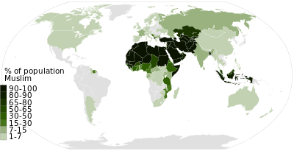
MUSLIMS AROUND THE WORLD

Slide 5

LANGUAGE
As mentioned earlier, Islamic people live all over the world. The original language spoken by Muslims is Arabic and although they still recite their prayers in the Arabic language, most Islamic people speak the local language wherever they happen to live.
When providing health care services, it may be necessary to provide an interpreter. Most Islamic people prefer to have a same sex interpreter, especially in the health care setting. Much of this is due to modesty, especially if the issue is related to reproductive or sex organs.

Slide 6
PRINCIPLES OF ISLAM
Muslims prescribe to the belief that there is only one god, which they call Allah. They believe in many prophets (people chosen by God to speak for him) including Abraham and Moses. Although they believe in Jesus Christ, he is viewed as another prophet, not the Son of God. According to Islam, Muhammad received messages from Allah and delivered them to the people. He was the last and most perfect of Allah’s prophets.
The word of Allah, as he told it to Muhammad, is recorded in the Qur’an or Koran, which is the holy book of Islam. Muslims believe the universe was created by Allah, all children are born free from sin and all people can find salvation on their own once God has chosen the way for them.
Islam teaches that Allah always wants to forgive people’s sins and that on the Last Day, when the world comes to an end, each person will be judged and rewarded with heaven or punished with hell.

Slide 7
Values of Islam
Ethical values: Muslims value and are being judged by the relations they have with people who are close to them and by things that they have control over, excluding materialistic achievements.
Family: Is a fundamental of Muslim life. To care for a family and kinship group is the main objective for Muslims. In this culture every man must have a wife. Marriage is considered a religious practice.

Slide 8
Values of Islam
Positive attitudes: Islamic culture discourages sadness, feelings of despair, or powerlessness. Most negative emotions are go against religious beliefs and are viewed as self-destructive qualities.
Work: Muslims believe that any type of work is beneficial to a community and it increases the self-esteem, which contributes to better mental health of that person.
Polygamy: Qur’an teaches that a male can have up to 5 wives, but each one has to be treated equally. Despite the teaching, many Islamic countries forbid polygamy as the mental health of women in polygamous relationships are worse than in monogamous.

Slide 9
Values of Islam
Adultery: In Islam the adultery is forbidden and is punished by a physical infliction of 100 lashes.
The use of intoxicants: Is forbidden as it is viewed as self-distraction, thus it affects the community as a whole.
Although Islam is the old religion and is “written in stone”, it has some fluency as Muslims incorporate newest scientific and social research in to their believes, as for example the use of tobacco. Findings proved the adverse effects of the use of tobacco and Islam incorporated this fact into their believes.

Slide 10
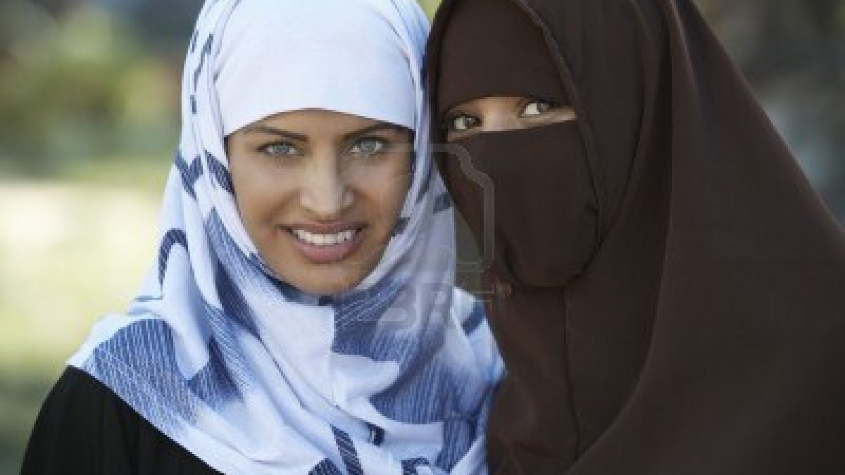

DAILY LIFE AND PRACTICES
Islamic people have basic beliefs that are to be followed in their culture.
There is the expectation to live according to Islamic law, which is called Sharia, or “God’s Way”.
Some of the things that are prohibited are stealing, lying, committing adultery, gambling, eating pork or drinking alcohol.
  Because they do not drink alcohol there is not a high prevalence of alcohol related diseases of the liver
The Qur’an, their holy book, instructs men and women to dress modestly. In some countries a woman must cover her head or face. Men generally wear a beard just as Mohammad did.
The status of women varies in each Islamic state. Some countries have greater equality between men and women while others limit the rights of women. Women do have a right to vote, obtain a good education and be employed.
Islam also teaches respect for parents, helping the poor, faith in God, kindness, honesty and hard work.

Slide 11
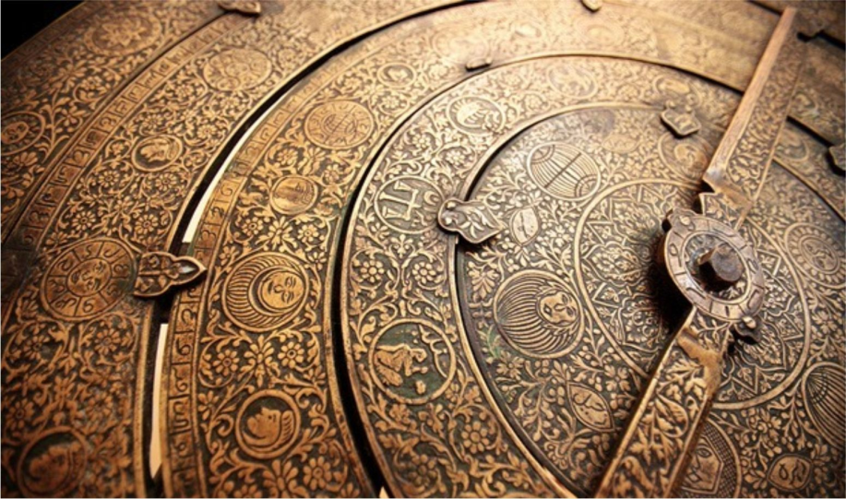
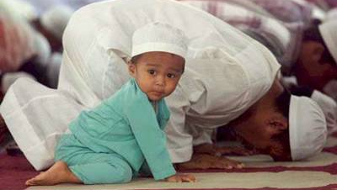
DAILY LIFE AND PRACTICES
Every culture has definite expectations that guide the shaping of boys and girls into two very distinct personalities; the Middle East is no exception. Almost from the beginning of a person’s life, the attitude of the males in Islamic culture being superior to females is greatly emphasized. The result is idealized roles of males and females, which has a huge impact on not only the social order, but on almost all levels of interpersonal relations.
Children of Islamic families in the Middle East learn at a very young age that the preservation of family and tribal traditions is of utmost importance. Therefore, in terms of the concept of time, more emphasis is placed on the past than the future. In addition, just as the traditions of their ancestors are not forgotten, they also do not easily forget battles and perceived humiliations, regardless of whether these events occurred long ago.
Many tribal cultures view the social graces, being polite, showing respect and personal interactions as more important than being on time. Unlike many Western cultures, most Arabs do not equate time and money. They consider social interaction before, during, and after meetings as highly important.

Slide 12
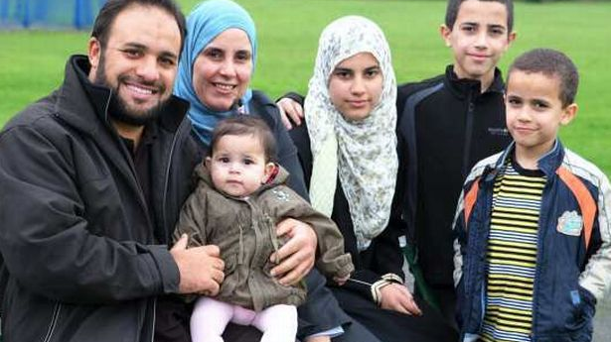
FAMILY STRUCTURE
In our current era, the nature, function, and structure of the family have been called into question. An unmarried couple, a single mother, and homosexual couples are seen by many as equally legitimate versions of the family unit. Islam is more conservative, viewing the family as a divinely inspired institution, with marriage at its center.
The family unit is considered the cornerstone of a healthy and balanced society. Traditional Muslim families often span three or more generations. There are multiple advantages to an extended structure including stability, cohesiveness, and physical and psychological support, especially in times of need.

Slide 13
FAMILY STRUCTURE
As in many traditional cultures, respect and esteem increase with age. Elderly parents are shown respect due to their life experiences and their position within the family unit. It is considered a gift from Allah to be able to care for one’s parents in their later years of life.
The man is considered the head of the family. Many see this as a double edged sword because leadership also requires responsibility. Even in a family where the wife earns money, economic responsibility for maintaining the family is considered solely the responsibility of the man.
The integrity of the family can be greatly affected by unemployment, leaving the man feeling a sense of being in oblivion. In such situations, psychological morbidity may be high, with consequences for the entire family.

Slide 14
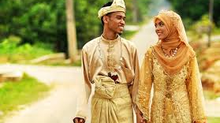
FAMLY STRUCTURE
You are a garment to them, and they are a garment for you.
Qur’an⁷
This Qur'an simile captures the primary goals of marriage—to provide warmth, comfort,
and protection and to beautify. The Islamic perspective includes children having a right to be born and raised in a stable and secure environment; marriage is the way to provide this environment.

Slide 15
FAMILY STRUCTURE
On the polar end, celibacy and sex outside of marriage are strongly discouraged because they are viewed as behavioral extremes that are in opposition to a wholesome society.
Marriage is considered the joining of two families, usually arranged by the parents. Although voluntary consent of both the bride and groom are required, many times there is a strong feeling of coercion. Apparently, some parents are beginning to grasp the marital concerns of their children. However, both young and old still consider it important to choose marriage partners from within one's community.

Slide 16
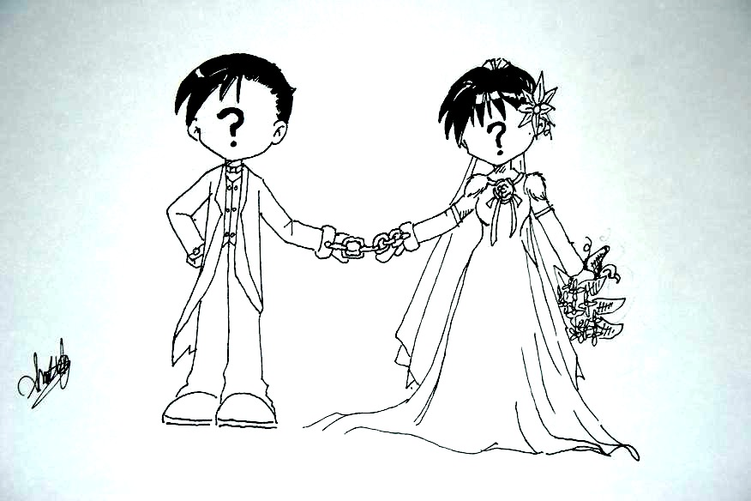
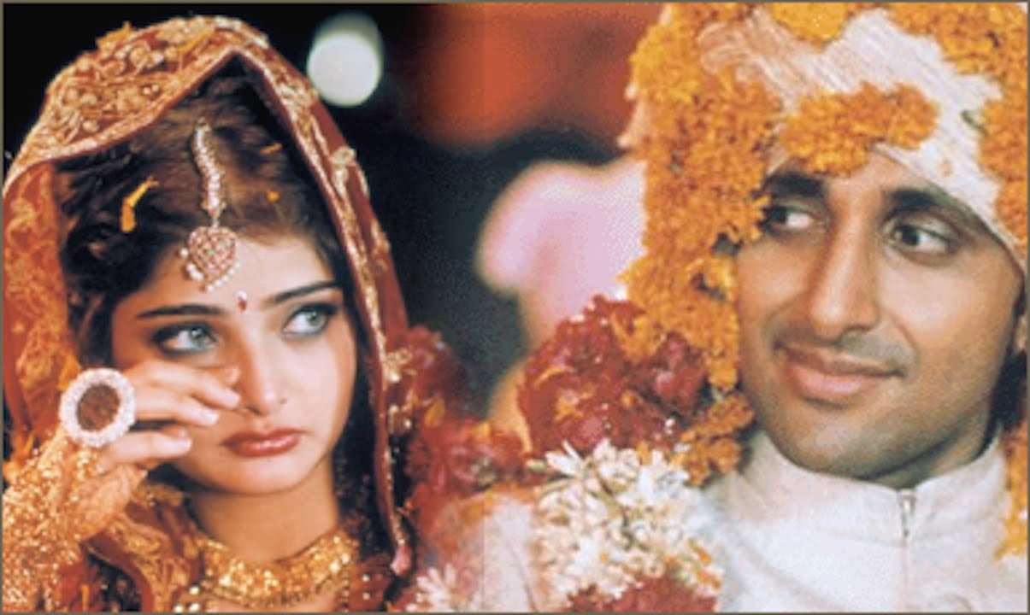

Slide 17
Ramadan
Ramadan is the monthly fasting to practice increased self discipline and the time of increased prayer and charity
1.8 billion around the world participate except those suffering from an illness, travelling, elderly and the young, pregnant, breastfeeding, or diabetic
Fasting will begin the evening of May 15 2018 and go to the evening of June 14 2018
During this time participants will eat after the sun goes down and before the sun goes up – not eating or drinking during the day, including water

Slide 18
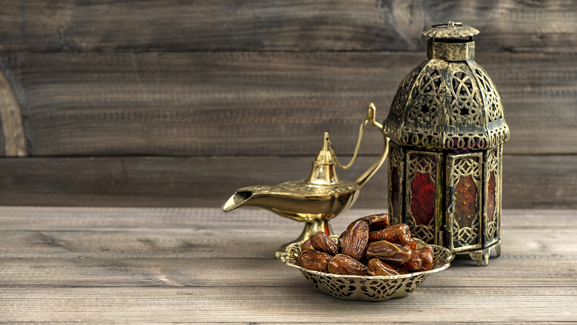

Slide 19
Ramadan and Epidemiology
During Ramadan there is an increase of dehydration because of not drinking anything during the day
A study has shown that fasters tend to have more headaches and tend to experience more fatigue during Ramadan
Sleep patterns can change during fasting because of the change in eating patterns
  Takes longer to fall asleep
  Get less dream sleep or deep sleep which is needed to feel rejuvenated for the next day
Fasting may cause complications with taking medications as well, something that needs to be addressed before beginning a fast

Slide 20
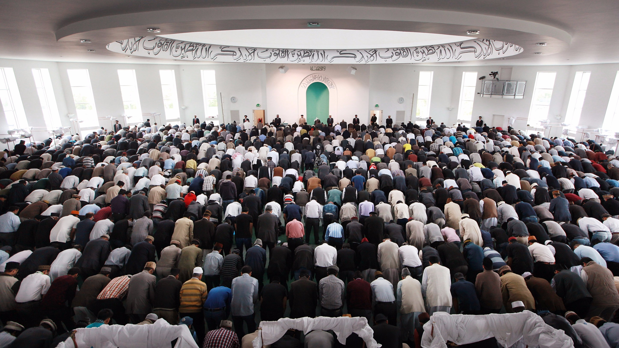

Slide 21
Epidemiology of the Muslim World
Epidemiology of Muslims depends largely on the region the religion is being practiced.
The most common cause of morbidity among all Muslim countries is suicide, especially among young females who have been forced into arranged marriages rather than choosing their own spouse
Developed nations are suffering from epidemics like polio (Nigeria), AIDS epidemic is prevailing in most Muslim countries and obesity (especially for women) in oil-rich countries.
Cardiovascular disease cases are prevailing in the Muslim world compared to the rest of the countries.

Slide 22

Health Care Needs
Many Islamic people prefer to be treated by someone of the same sex during medical procedures because it is prohibited to be alone in a closed space with someone who is not family
In the Islamic culture, modesty is important. The heath care facility needs to understand by,
  Keeping patient covered when with a non-mahram or someone who is not family by blood or marriage
  During surgical procedures most women want to keep their modesty by covering their heads

Slide 23
Barriers to a Healthy Lifestyle
When treating people in the Islamic culture, it is important to respect their beliefs, although it may lead to barriers in their health. Some of these beliefs include:
Gender preference.
Many women may not want to seek healthcare because they believe it is a sign of weakness.
Do not resuscitate orders are consistent.
Modesty
May not seek professional care because of their belief in spiritual healing like prayer and meditation.
May believe illness is part of God’s plan and will delay seeking treatment.

Slide 24
Health Barriers Related to Diet
Because medications containing alcohol and pork by-products must be avoided by people of the Islamic culture, changes may need to be made in order to comply with their beliefs
Medications that contain alcohol or pork by-products are not used unless it is a life saving drug or procedure that has no substitutes.
While most prohibited foods are easy to identify, some foods may contain ingredients and additives that can make them prohibited. For example, because vanilla essence contains alcohol, foods containing vanilla essence are prohibited. Foods like ice cream or Jell-O may contain pork by-products like as gelatin, which is prohibited.

Slide 25
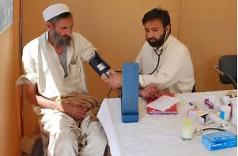
Barriers to a Healthy Lifestyle
To properly address the barriers of the Islamic community, our professionals should be educated on beliefs and practices. If Islamic teachings are integrated into our healthcare delivery, appropriate care can be provided and healthy behaviors can be promoted.

Slide 26
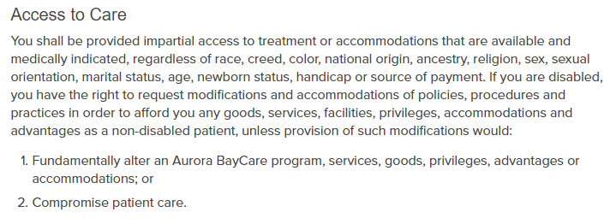
Availability in N.E.W.
This is an example of the non-discriminatory act at Aurora BayCare.
All healthcare facilities in N.E.W. have a non-discriminatory rule set in place where everybody is accepted no matter what their race, religion, or gender, etc.
Language barriers should not be a problem at any healthcare facility due to available translators.
If the patient prefers to be treated by a Muslim specific health facility they will have to travel to Milwaukee. The closest place that specializes in this religion is called Muslim Community and Healthcare Center.

Slide 27


Availability in N.E.W.
Muslim Community and Healthcare Center website.
This example from Bellin Health shows how
patients can select their language.

Slide 28
Real Stories of Experiences with Aurora
Understanding and creativity provide for religious birthing experience - Walworth Community
Modesty and childbirth usually do not go together. However, when a Muslim couple came into Aurora Lakeland Medical Center to have their child, the OB nurses and other staff showed a deep understanding of their cultural requirements and thought of creative ways to address their needs. Female modesty is a basic principle of the Islamic culture. Women wear loose fitting clothes and head coverings in public.
After learning that the soon-to-be Mom normally wears a veil in public, Barb Greene, nurse extern, talked with them. The couple very openly shared their beliefs and their concerns about privacy. "Not only was I interested, but I also realized how important it was to them and how sensitive we needed to be," said Barb. The couple was particularly concerned about any men seeing her, as she would not be wearing her veil during her stay.
The staff started brainstorming ways to give her the privacy she required. They brought in a screen to cover the entry of her room, so when the door was opened, she was not immediately visible.
The nurses quickly realized there were many opportunities that men may enter the woman's room, such as food services staff with trays, laboratory technicians for blood draws, and volunteers with flowers or cards. They made urgent calls to the appropriate areas to assure that only women would be sent to the patient's room.
Also, when the woman received her epidural, the nursing staff made sure that only a small amount of her skin was visible to the caregiver.
The couple expressed their deepest feeling of appreciation to all the caregivers, stating that the entire Aurora staff showed very high professionalism and worked together as a team to satisfy their special needs. They are letting their family, friends, colleagues and neighbors know of the sensitive care they received at Aurora Health Care.

Slide 29
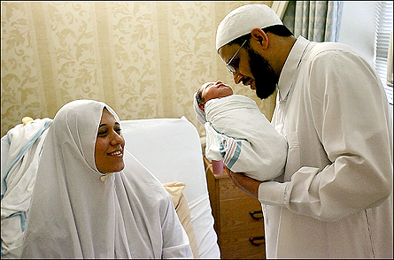
Real Stories of Experiences with Aurora
Embracing other cultures - Aurora Medical Center – Oshkosh
An eastern Indian couple was blessed with the gift of a child here in our unit. According to their customs they have two special rites that involved the parents as well as the baby’s grandparents.
Our nurses in Labor & Delivery worked with this couple so they could perform these rituals, which were so important to their culture. One was a breastfeeding ritual that involved the grandparents and the other was an incense burning and blessing. Everything turned out so very well because our staff did all in their power to make sure that the patients emotional and spiritual welfare was also taken care of while here.
https://iconnect.aurora.org/DotNetNuke/Default.aspx?tabid=4820

Slide 30
Works Cited
“A Commitment to Community.” MCHC, mchcwi.org/.
Culture Matters. Military Intelligence Professional Bulletin, (Jan-Mar 2005, Vol. 31 Issue 1) Van Otten, G.A. Retrieved from http://eds.a.ebscohost.com/eds/detail/detail?vid=0&sid=ba14020e-d4db-4bdd-bc28-6 (Chart of muslim population)
English Online, Articles in Easy Understandable English for Learners. Retrieved from http://www.english-o nline.at/religion/islam/pillars-and-beliefsof-islam.htm, (n.d. and no author listed).
“Health Care in Islamic History and Experience.” Health Care in Islamic History and Experience EthnoMed, ethnomed.org/cross-cultural-health/religion/health-care-in-islamic-history-and-experience.
Koenig, H. G., Shohaib, S. A. (2014) Health and Well-Being in Islamic Societies Background, Research, and Applications. DOI:10.1007/978-3-319-05873-3
Khan, S. (2011, August 22).Fasting During the Month of Ramadan can Cause Headaches,Fatigue and Dehydration. The Washington Post.
Laird, D. Amer, M. Barnett, E. Barnes, L. (2007, October) Muslim Patients and Heath Disparities in UK and the US.
“Quora. Karol Emil Thornton-Remiszewski. (May 19, 2016). Retrieved from https://www.quora.com/What-languages-are -most-widely-spoken-by-Muslims.
Rabin, R. (2010, November 1) Respecting Muslim Patients Needs. New York Times.

Slide 31
Rights and Responsibilities.” Aurora BayCare Medical Center, www.aurorabaycare.com/patient-and-visitor-information/rights-and-resposibilites.
Taheri. N. (2088, May 01). Health Care in Islamic History and Experience. Retrieved from http://ethnomed.org/cross-cultural-health/religion/health- care-in-islamic-history- and-experience.
University of Chicago Medicine. (2011, August 12). Religious Beliefs Shape Health Care Attitudes Among US Muslims.
Western Journal of Medicine (WJM),( Nov 2000), retrieved from https://www.ncbi.nlm.nih.gov/pmc/articles/PMC1071164/.
When Culture or Religion Becomes a Barrier to Good Health Care.” Pittsburgh Post-Gazette, www.post-gazette.com/news/health/2016/07/26/Fulbright-Scholar-from- Duquesne-Studies-How-Islamic-Religion-and-Culture-Impacts-Breast-Cancer-Prevention/stories/201607190007.
Zakir, N. (2011, July 19) In Islam, Is smoking Haram or Makruh? [video file]. Retrieved from https://www.youtube.com/watch?v=QMKfBm2P5Eo

