Slide 1
Falls prevention
What you should know

Slide 2
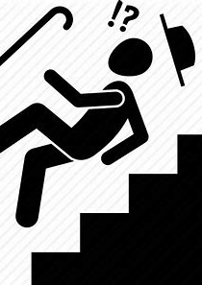

As we get older, falling is common but it is not normal

Slide 3
Facts about falls
Falls are the leading cause of fatal and non-fatal injuries in people 65 and older
Even if a fall doesn’t kill you it can drastically change your life
Falls can result in broken bones, hip fractures and head injuries
Even minor falls can cause “fear of falling” or depression which makes it more difficult to stay active
Sometimes broken bones don’t heal properly and can be more likely to break again in the future

Slide 4
Every 11 seconds a senior is seen in an emergency room for a fall-related injury
One out of three older adults falls each year
Within 6 months, 2/3 of those will fall again
Men are at a greater risk of dying due to a fall than women. However, women are more often injured from a fall than men. For example, hip fracture rates are over double of those for men.

Slide 5
Seniors over 75 are up to five times more likely to be admitted to a long-term care facility for a year or more after a fall than those age 65 to 74.
Chances of serious injury from falling increase by four times for seniors 85 and older when compared to those 65 to 74.

Slide 6

The Cost of Falling
1 out of every 5 falls cause broken bones or a head injury
Each year 2.8 million older people are treated in the emergency room due to fall injuries and 800,000 are hospitalized
300,000 older individuals are hospitalized for hip fractures
In 2015, the total medical costs for falls totaled more than $50 billion. Medicare and Medicaid covered only 75% of these costs.

Slide 7


Slide 8
FALLS
ARE
PREVENTABLE

Slide 9
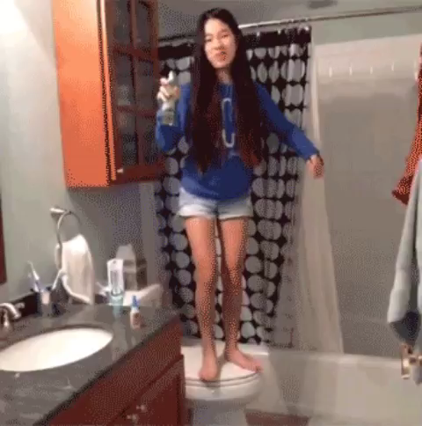

Slide 10
Fall prevention is a variety of actions to help reduce the number of accidental falls suffered by older people. Falls and fall related injuries are among the most serious and common medical problems experienced by older adults.
Fall prevention - Wikipedia en.wikipedia.org/wiki/Fall_prevention

Slide 11
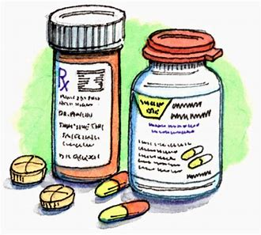
Common factors that lead to a fall
Balance and gait: Most of us lose some coordination, flexibility, and balance as we age; this is often due to inactivity, making it easier to fall.
Medications: Some medications, both prescriptions and over-the-counter, can cause dizziness, dehydration or may cause interactions with each other that can lead to a fall.

Slide 12
Environment: There are many simple modifications that can be made in the home to make it safer as you age. Most seniors have lived in their homes for a long time and have just never thought about it.
Vision: As the eye ages, less light reaches the retina which makes contrasting edges, tripping hazards, and obstacles more difficult to see.
Chronic conditions: Over 80% of seniors have at least one chronic condition such as diabetes, stroke, or arthritis. These conditions can often increase the risk of falling because they result in lost function, inactivity, depression, pain, or multiple medications.

Slide 13
Preventing falls in Home environment
The 2 most common places where falls happen in homes are the bathtubs and stairs.
Preventing falls in your bathroom
  non-slip decals in shower/tub
  handrails in shower and or by the toilet

Slide 14
Preventing falls by your stairs
  Having handrails on both side of the stairs
  Having lighting along the staircase
  Color contrast between the steeps
  Applying non-slip decals
Make areas well lighted and free of clutter to help preventable falls

Slide 15
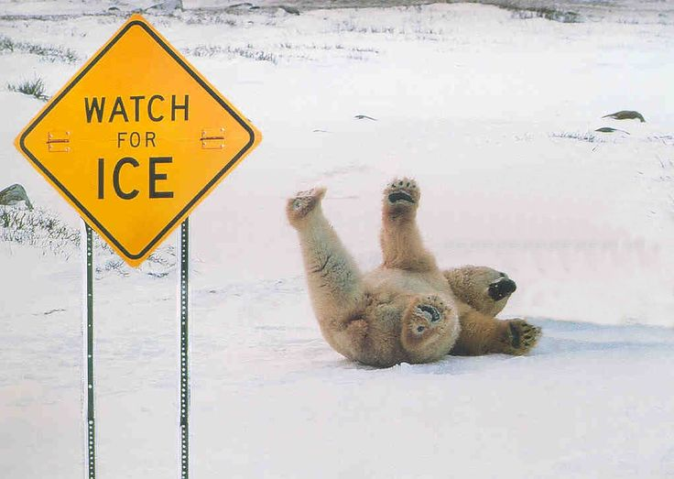
Watch out for slippery walk ways in winter

Slide 16
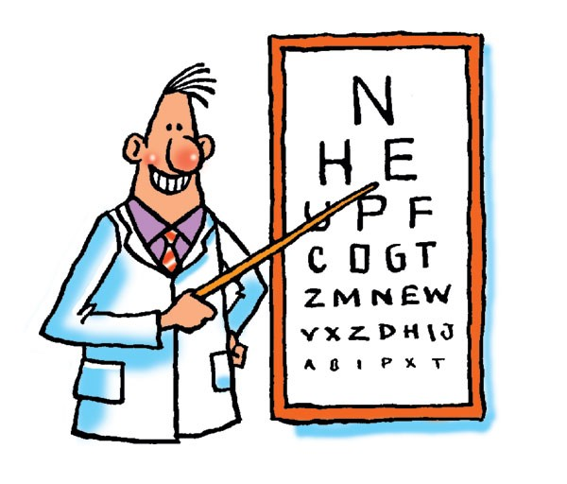
Preventing Falls For Everyone
Regular exercise helps maintain strength and flexibility, helping to reduce falls… low weight bearing exercises like walking may reduce the risk of osteoporosis
Get your eyes tested! Changes in vision can increase your chance of falling
Read medication side-effects, some medication can cause dizziness
Make sure walk ways are clear of clutter and well lighted

Slide 17
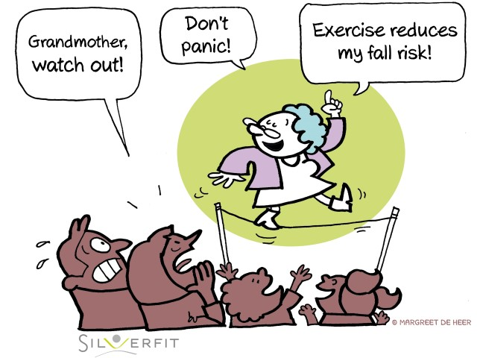

Slide 18
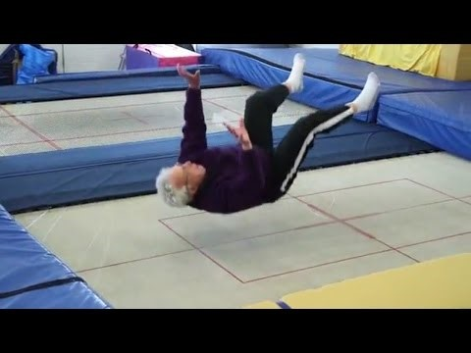
Falling safely
https://youtu.be/Fyan2o7PaxA

Slide 19
Local Resources
Stepping On Program - Shannon Myers is a trainer at the Wisconsin Institute for Healthy Aging.
  This is a workshop to prevent falls
Who is this for?
  At risk for falling
  Have a fear of falling
  Who have fallen one or more times

Slide 20
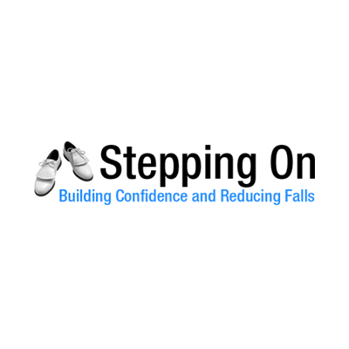
Stepping on program
Subjects covered in Stepping On:
  Strength and balance exercises
  How vision plays with keeping you balance
  How taking some medications lead to falls
  How to stay safe when outside in your community
  Home safety
  Selecting the right footwear
Benefits of the program:
Learn to step with confidence
Learn with people your age
Up to date information on fall prevention
Be able to share what you learned

Slide 21
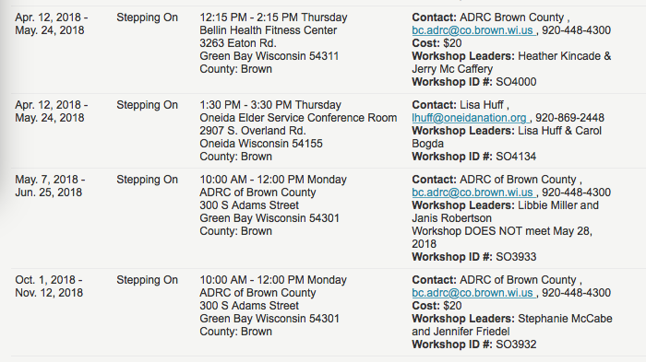
Upcoming Fall prevention programs in the brown county area -

Slide 22
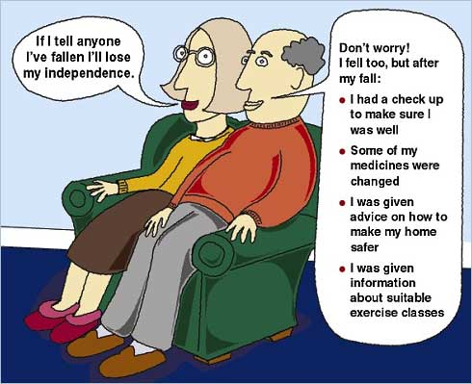

Slide 23
WORKS CITED
Preventing Falls and Fractures. 2017. National Institute For Aging https://www.nia.nih.gov/health/prevent-falls-and-fractures
Important Facts About Falls. Center of Disease and Control. https://www.cdc.gov/homeandrecreationalsafety/falls/adultfalls.html
Fall Prevention with Stepping On. Wisconsin Institute for Healthy Aging. https://wihealthyaging.org/stepping-on
National Council on Aging, (2018), Retrieved from https://www.ncoa.org/healthyaging/falls-prevention/preventing-falls-tips-for- older-adults-and-caregivers/6-steps-to- protect-your-older-loved-one-from-a -fall/
Seniorliving.org, (2001-2018). Retrieved from https://www.seniorliving.org/healthcare/senior-fall-prevention/

